Slide 1
A Big Data Pipeline for Smart Agriculture
Crop stress prediction and live disease alerts from 47 GB of satellite, weather, soil and IoT data with Hadoop (HDFS, YARN, MapReduce), Spark, Scala, Spark ML and Kafka
Chaitanya Jayasurya J
CB.AI.U4AID24010
Sri Sai Nandini
CB.AI.U4AID24008
Sritha Manasa
CB.AI.U4AID24027
Siva Sashreek
CB.AI.U4AID24054
Faculty In Charge: Dr. Sreeja B
23AID302 – Big Data Analytics
Final Project Review
Team (23AID302)
Smart Agriculture Big Data Pipeline
Final Project Review · 1 / 10
Notes:
Introduce the team and the project in one line: a full big data pipeline on a 5-DataNode Hadoop cluster that turns 47 GB of satellite imagery plus weather, soil and live sensor data into crop-stress predictions and live disease alerts, all written in Scala.

Slide 2
Problem statement, objectives and why Big Data
Problem statement
Objectives
Why Big Data is needed
Crop stress and fungal disease are noticed too late to act
Early signals exist in satellite images, weather and soil, but in different formats and sizes
No single machine can join 47 GB of imagery with weather and soil field by field, or watch thousands of sensors live
Store 47 GB of raw data on a 5-DataNode Hadoop cluster
Clean and join satellite, weather and soil with Scala Spark jobs
Predict which 1.1 km fields will be stressed at the next satellite pass
Stream live IoT readings through Kafka and raise disease alerts
Prove every result is free of data leakage
Volume: 47 GB raw, 141 GB stored with 3 replicas
Variety: JPEG2000 imagery, NetCDF weather, GeoTIFF soil, JSON sensor streams
Velocity: 1,000 sensor readings per second
Needs distributed storage (HDFS) and parallel processing (Spark, MapReduce on YARN)
Team (23AID302)
Smart Agriculture Big Data Pipeline
Final Project Review · 2 / 10
Notes:
Problem: stress and disease are found too late. Objectives: store at scale, clean and join with Scala Spark, predict stress at the next satellite pass, stream sensors through Kafka, and prove no leakage. Why big data: the three Vs, with real numbers.

Slide 3
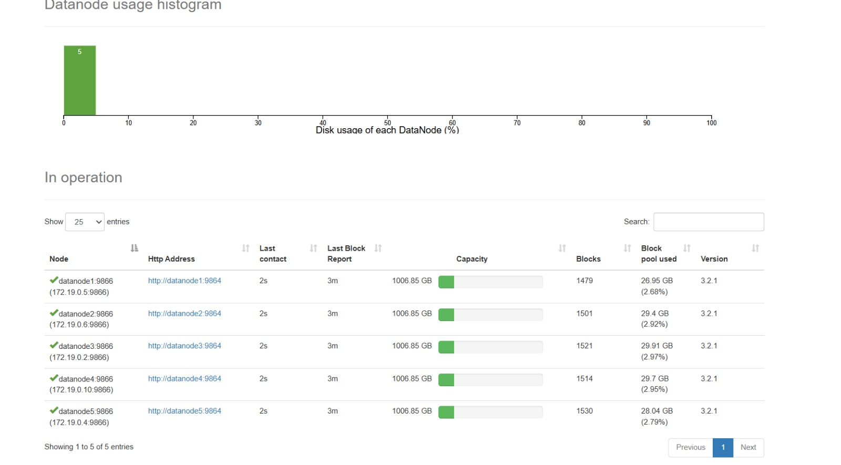
Dataset: source, size, the 4 V’s and key attributes
Dataset | Source | Size | Used for
Sentinel-2 L2A | ESA Copernicus | 41 zips, 47.0 GB | Red, NIR, cloud mask → NDVI per field
ERA5 | ECMWF (CDS) | NetCDF4, 29,565 rows | Daily weather 2023, 81 grid points
SoilGrids | ISRIC | 7 GeoTIFFs, 4.1 MB | pH, nitrogen, carbon, texture
IoT sensors | Simulated (Kafka) | 110,000 messages | Live disease and water-stress alerts
Final dataset | Our Scala ETL | 393,340 rows | 19,916 fields × 40 dates; every model
Volume: 47 GB in HDFS, 409 blocks, fsck HEALTHY
Variety: JPEG2000, NetCDF4, GeoTIFF, JSON
Velocity: 200 fields × 5 sensors, 1 reading/s each
Veracity: duplicate zip dropped by checksum; clouds masked; nodata gap-filled
Key attributes: tile, cell_row, cell_col, date, lat, lon, NDVI, cloud fraction, soil water, temperature, rain, pH, clay, sand
Team (23AID302)
Smart Agriculture Big Data Pipeline
Final Project Review · 3 / 10
Notes:
Sentinel-2 is the volume. One zip was a byte-identical duplicate, caught by HDFS checksum. ERA5 is 2023 only, by scope decision. The screenshot is the live NameNode page: 5 DataNodes, blocks spread evenly because of replication factor 3.

Slide 4
Methodology and system architecture
① INGESTION + PREPROCESSING (batch, Spark on YARN)
Raw sources
HDFS raw zone
3 Scala Spark jobs
HDFS processed
Sentinel-2 47 GB, ERA5, SoilGrids
5 DataNodes, rf 3, 128 MB blocks
Sentinel: cloud mask, NDVI, 1.1 km grid · ERA5: daily, °C, RH · Soil: resample, gap-fill
Parquet, partitioned by tile / date
② INTEGRATION + MACHINE LEARNING (reads HDFS processed)
Canonical join
Features
Spark MLlib
Conformal + decisions
Results
393,340 rows; nearest ERA5, 1:1 soil
lags, rolling stats, T+1 target, date split
GBT, RF, LR vs naive baseline
α = 0.10; 3 action levels
HDFS results/, dashboard
③ REAL-TIME STREAMING (Kafka + Spark Structured Streaming)
IoT simulator
Kafka topic
Structured Streaming, every 10 s
Alerts out
200 fields × 5 sensors, 1/s
iot_sensor_readings, 6 partitions
per-sensor adaptive Kalman state + soil + satellite context → risk rules
Kafka crop_alerts + HDFS
④ SUPPORTING JOBS
Hadoop MapReduce: mean NDVI per tile per month
Kalman experiment: 2,000 series × 11 scenarios
Leakage audit: 23 automated checks
Team (23AID302)
Smart Agriculture Big Data Pipeline
Final Project Review · 4 / 10
Notes:
Read it top to bottom. Lane 1: raw files go into HDFS and three Scala Spark jobs clean them back into HDFS. Lane 2: the processed data is joined into one table, features and a future target are built, models are trained and compared with baselines, then conformal prediction and a decision engine. Lane 3: the live path through Kafka and Spark Structured Streaming. Lane 4: supporting jobs, including the classic MapReduce job. Everything runs on YARN; one command, bash scripts/run_pipeline.sh, runs all 14 stages.

Slide 5
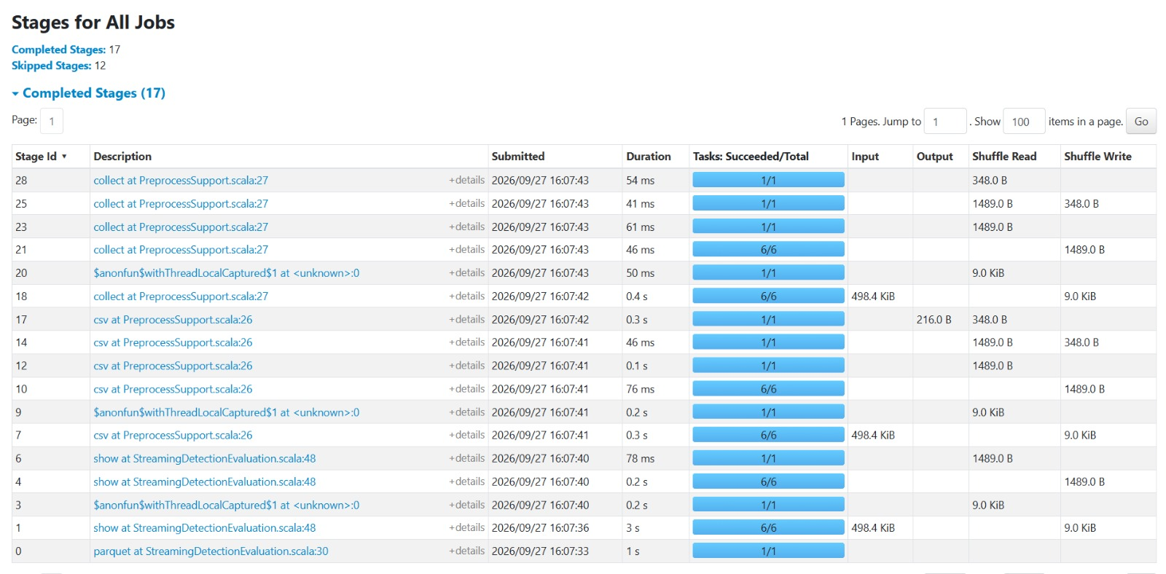
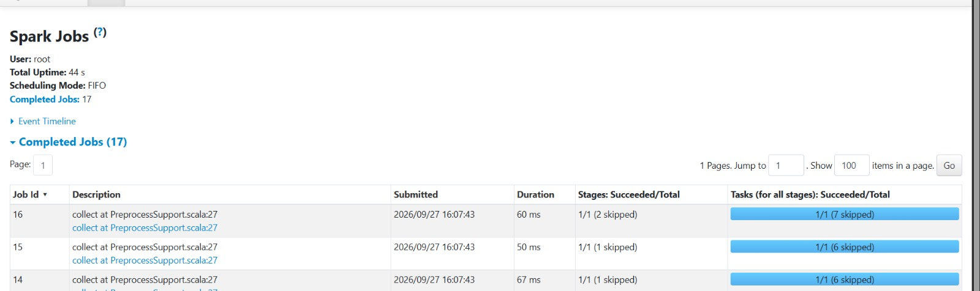
Spark workflow: RDD / DataFrame operations, DAG, partitioning, caching
RDD API: parallelize(40 products), map(decode), mapPartitions for the sequential Kalman filter
DataFrame API: select, filter, groupBy + agg, join, pivot, window functions (lag, lead, rolling); optimised by Catalyst
Lazy: transformations build a plan; actions (count, write, show) start a job
DAG: each job is split into stages at every shuffle; 10 apps, 674 jobs, 866 stages, ~9,100 tasks
Partitioning: 40 partitions for Sentinel decoding; 64 shuffle partitions + AQE; repartition by field; HDFS partitionBy tile / date
Caching: persist(MEMORY_AND_DISK) the decoded products (reused by 2 actions); broadcast ERA5 grid and soil rasters
Executors: 3 per job on 2 YARN NodeManagers
Spark History Server (localhost:18080): stages with shuffle read/write, and jobs with stages and tasks
Team (23AID302)
Smart Agriculture Big Data Pipeline
Final Project Review · 5 / 10
Notes:
Point at the screenshot: every row is a stage; Tasks shows partitions processed; Shuffle Read and Write show data moving between executors, which is exactly where stages split. Offer to open the live Spark History Server and the DAG Visualization.

Slide 6
Scala implementation: key code and project structure
Cloud-masked NDVI per field (Sentinel2Preprocess.scala)
Project structure
val zip = new ZipFile(new HdfsSeekableChannel(fs.open(p), size))
val red = Jp2Decoder.decode(entryBytes(zip, "_B04_20m.jp2"))
// ... same for B8A (NIR) and SCL (cloud mask)
if (SceneClass.isClearLand(scl)) {
val ndvi = (nir - red) / (nir + red)
sum(cell) += ndvi; clear(cell) += 1
}
smartagri/
preprocess/ HDFS → HDFS
canonical/ join
mapreduce/ MR job
features/ target, split
kalman/ filter
ml/ MLlib
streaming/ Kafka
audit/ leakage
Sequential Kalman filter on Spark (KalmanFusionPipeline.scala, simplified)
obs.repartition($"tile", $"cell_row", $"cell_col")
.sortWithinPartitions("tile", "cell_row", "cell_col", "date")
.rdd.mapPartitions { rows =>
cellByCell(rows).flatMap(runCellSequential) // 1 field in memory
}
67 Scala files, 246 unit tests
sbt assembly → 1 jar → spark-submit --master yarn
run_pipeline.sh: 14 stages, 1 command
Team (23AID302)
Smart Agriculture Big Data Pipeline
Final Project Review · 6 / 10
Notes:
Snippet 1: a Sentinel-2 zip is 1.2 GB; our HdfsSeekableChannel lets each executor read only the 3 bands it needs (2.86 GB of 49.3 GB). Pixels flagged cloud or shadow by the SCL band are skipped. Snippet 2 (simplified): a Kalman step needs the previous step's output, so it cannot be a window function; we repartition by field, sort by date and stream one field at a time in mapPartitions.

Slide 7
Spark ML pipeline: features, algorithms, tuning
Target and features
Tuning (on a validation date inside training)
Target: field stressed at the next satellite pass (NDVI more than 1 std below its own history), from data up to now only
Features (19): NDVI, lag, change, rolling mean/std, frozen baseline, soil, season, current anomaly
Split by date at 2024-04-07: 105,848 train, 48,747 test rows; never random
Model | Hyper-parameters | Val. ROC-AUC
Gradient boosting | depth 3, 40 iter. | 0.894
Gradient boosting | depth 3, 80 iter. | 0.890
Random Forest | 100 trees, depth 8 | 0.881
Gradient boosting | depth 5, 40 iter. | 0.874
Gradient boosting | depth 5, 80 iter. | 0.868
Algorithms (Spark MLlib)
VectorAssembler → GBTClassifier / RandomForestClassifier / LogisticRegression, class-weighted
Baselines on identical rows: naive “stressed now → next”, majority class
Uncertainty and decisions
Split conformal prediction, α = 0.10, calibrated on the last training dates
Decision engine: LowRisk / Monitor / InvestigatePriority
Leakage audit: 23 / 23 checks pass
Team (23AID302)
Smart Agriculture Big Data Pipeline
Final Project Review · 7 / 10
Notes:
Validation date was 2024-03-18, inside training; the test months were never used to pick the model. Gradient boosting depth 3 with 40 iterations won on validation, so it is the primary model.

Slide 8
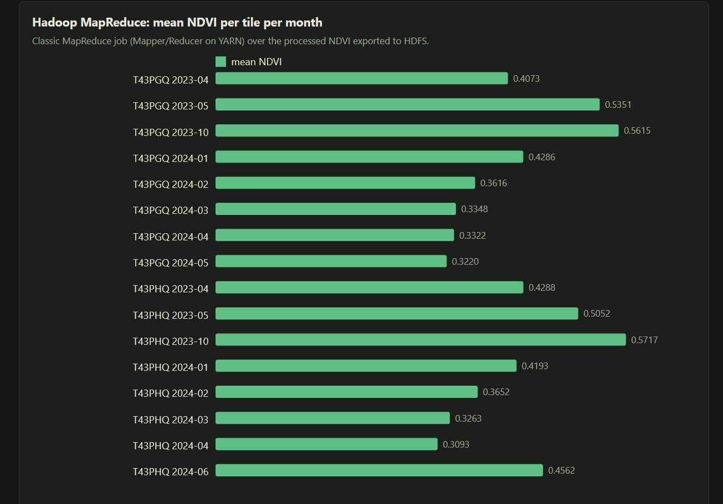
Results: metrics, model comparison and business insight
Next-pass stress prediction, test period Apr–Jun 2024 (48,747 rows)
Model | Accuracy | ROC-AUC | Recall (stressed)
Naive rule (stressed now → next) | 0.701 | 0.765 | 0.517
Random Forest + anomaly feature | 0.696 | 0.727 | 0.497
Logistic regression | 0.639 | 0.707 | 0.001
Gradient boosting (primary) | 0.675 | 0.675 | 0.445
Random Forest, original features | 0.629 | 0.656 | 0.174
Majority class | 0.361 | 0.500 | 1.000
MapReduce: mean NDVI per tile per month; green peaks in Oct 2023, dry-season low in Apr 2024
58 / 59 · 0 false
−54% / −22%
at-risk fields caught live by Kafka streaming; 0 alarms in 141 healthy (simulated)
Kalman error with 15% outliers / 20% bias (+15% on clean data)
Insight: last pass’s stress is the strongest early warning
Live sensors add same-day disease alerts
Drift + 4 training dates limit ML
80.7% vs 90%
55% · 46% · 22%
conformal coverage on test; drift breaks its assumption
fields really stressed when flagged Investigate · Monitor · LowRisk
Team (23AID302)
Smart Agriculture Big Data Pipeline
Final Project Review · 8 / 10
Notes:
Be upfront: no learned model beat the naive persistence rule on the test months. The model was chosen on a validation date, not on the test, so we report it honestly; validation ROC-AUC 0.894 dropped to 0.675 because of seasonal drift. Streaming and the Kalman filter work well; decisions rank risk correctly. The MapReduce chart shows the seasonal NDVI cycle.

Slide 9
Challenges, limitations, conclusion and future work
Challenges
Conclusion
JPEG2000 decoder rejected Sentinel files: wrote our own JP2 box parser
Library clashes on YARN: shaded the fat jar
Java 8 cluster, JDK 17 build: compiled with -release 8
Full pipeline HDFS → Spark (Scala) → MapReduce → Spark ML → Kafka streaming, 14 stages, all SUCCESS
Live alerts within one 10-second batch
Honest baselines show where ML still falls short
Limitations
Future work
ERA5 weather covers 2023 only
Soil and weather stop at 78°E (part of one tile)
IoT simulated; 5 DataNodes on one laptop
Real field sensors and a multi-machine cluster
2024 weather and more satellite dates
Retrain as seasons drift; merge small HDFS files
Team (23AID302)
Smart Agriculture Big Data Pipeline
Final Project Review · 9 / 10
Notes:
Challenges are engineering problems we solved. Limitations are stated openly and each has a fix listed under future work.

Slide 10
References and GitHub
ESA Copernicus. Sentinel-2 MSI Level-2A products, Copernicus Data Space Ecosystem.
Hersbach et al. The ERA5 global reanalysis, Q. J. R. Meteorol. Soc., 2020.
Poggio et al. SoilGrids 2.0: producing soil information for the globe, SOIL, 2021.
Zaharia et al. Apache Spark: a unified engine for big data processing, CACM, 2016.
Armbrust et al. Spark SQL: relational data processing in Spark, SIGMOD, 2015.
Dean, Ghemawat. MapReduce: simplified data processing on large clusters, OSDI, 2004.
Kreps, Narkhede, Rao. Kafka: a distributed messaging system for log processing, NetDB, 2011.
Welch, Bishop. An Introduction to the Kalman Filter, UNC TR 95-041.
Angelopoulos, Bates. A Gentle Introduction to Conformal Prediction, 2021.
GitHub: [your GitHub repository link]
Uploaded: this presentation and the project report
Team (23AID302)
Smart Agriculture Big Data Pipeline
Final Project Review · 10 / 10
Notes:
Replace the GitHub placeholder. Then switch to the live demo: HDFS at localhost:9870, YARN at localhost:8088, Spark History at localhost:18080, Kafka UI at localhost:8080.

